Slide 1
PAM4 BIRD 175 Introduction
Walter Katz
IBIS Open Forum
May 1, 2015

Slide 2
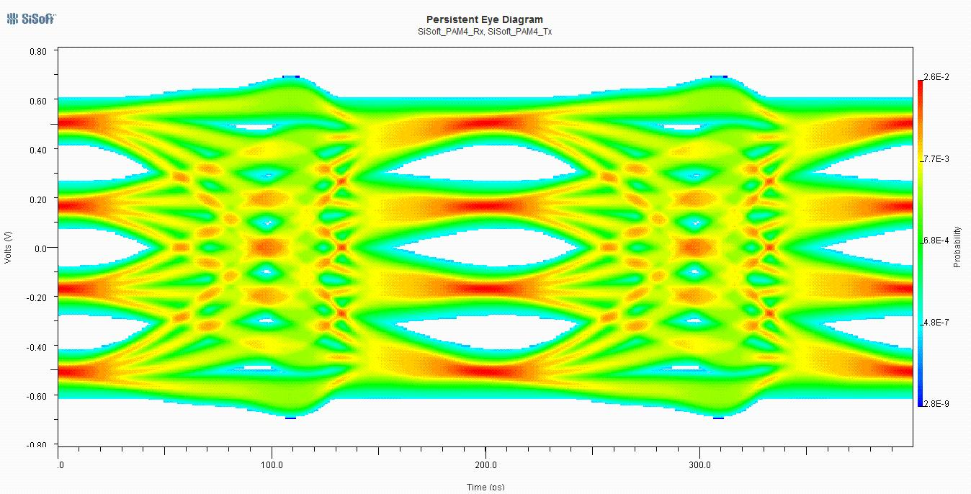
PAM4 – Four signal levels

Slide 3
Authors
SiSoft
Walter Katz
Todd Westerhoff
Mike Steinberger
Keysight
Fangyi Rao
Avago
Bob Miller
Xilinx
Hongtao Zhang

Slide 4
This BIRD
Makes a number of changes to the IBIS text to support both NRZ and PAM4 signaling.
Explains PAM4 stimulus pattern input to Tx AMI_GetWave
New Reserved Parameters
Declare model to be NRZ and/or PAM4
PAM4 voltage thresholds
Upper and lower eye timing offsets

