Slide 1
RDIMM Example Figures for BIRD202
Randy Wolff
Micron Technology
2/18/2020

Slide 2
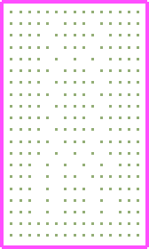
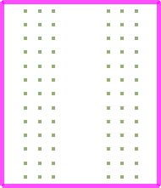
Designator Pin U3.B11
Net: BA07
U1
U2
U3
U4
U5
EMD Pin J1.211, Net A07
Figure X: DDR4 Registered DIMM containing DRAM components labeled by designators U1, U2, U4, U5 (front side) and U7-U11 (back side, not seen) and a Register component labeled by designator U3.
Also shown is pre-register Net A07 connecting from an EMD Pin to a Designator Pin of designator U3 and post-register net BA07 connecting from a Designator Pin of designator U3 to Designator Pins of designators U4, U5, U7, and U8 as well as termination resistor RN13.

Slide 3
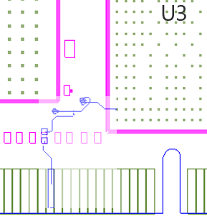
Designator Pin
U3.W1
R123
Net A07
Net A07r
EMD Pin
J1.211
Figure Y (Zoomed area of Figure X): An extended net A07 can be modeled by one EMD Model containing only terminals for J1.211 and U3.W1. The signal path containing net A07, the series resistor R123, and net A07r would be included in the EMD Model. Alternately, the EMD Model could include terminals for the pins of the series resistor, and the resistor would be assigned a designator referencing an IBIS component.

Slide 4
Designator Pin U3.B11
Net: BA07
Designator Pin U8.M8
Designator Pin U7.M8
Designator Pin RN13.7
Designator Pin U4.M8
Designator Pin U5.M8
Figure Z (Zoomed area of Figure X): Post-register net BA07 connects from the Register’s Designator Pin U3.B11 to the DDR4 DRAMs’ Designator Pins U4.M8, U5.M8, U7.M8, and U8.M8 as well as to one Designator Pin of the termination resistor RN13.

Slide 5
EMD Syntax Example Using DDR4 RDIMM Example
[Begin EMD] DDR4_RDIMM
[Number of EMD Pins] 9
[EMD Pin List] signal_name signal_type bus_label
203 VSS GND
211 A07
212 VDD POWER VDD1
[End EMD Pin List]
[EMD Designator Map]
U3 register.ibs DDR4_Register
U4 dram.ibs DDR4_Memory
U5 dram.ibs DDR4_Memory
U7 dram.ibs DDR4_Memory
U8 dram.ibs DDR4_Memory
[End EMD Designator Map]
[Designator Pin List] signal_name signal_type bus_label
U3.B9 VDD POWER VDD1
U3.B11 BA07
U3.B12 VSS GND
U3.V3 VDD POWER VDD1
U3.W1 A07
U3.W3 VSS GND
|
U4.K9 VSS GND
U4.M8 BA07
U4.N9 VDD POWER VDD1
U5.K9 VSS GND
U5.M8 BA07
U5.N9 VDD POWER VDD1
U7.K9 VSS GND
U7.M8 BA07
U7.N9 VDD POWER VDD1
U8.K9 VSS GND
U8.M8 BA07
U8.N9 VDD POWER VDD1
[End Designator Pin List]
[EMD Group] Just_One
Addr_07 NA
[End EMD Group]
[End EMD]
[EMD Set] Addr_07
[EMD Model] A07
File_IBIS-ISS A07.iss A07
Number_of_terminals = 6
1 Pin_I/O pin_name 211
2 Pin_I/O pin_name U3.W1
3 Pin_Rail bus_label VDD1
4 Pin_Rail signal_name VSS
5 Pin_Rail bus_label U3.VDD1
6 Pin_Rail bus_label U3.VSS
[End EMD Model]
[EMD Model] BA07
File_IBIS-ISS BA07.iss BA07
Number_of_terminals = 16
1 Pin_I/O pin_name U3.B11
2 Pin_Rail bus_label U3.VDD1
3 Pin_Rail signal_name U3.VSS
4 Pin_I/O pin_name U4.M8
5 Pin_Rail bus_label U4.VDD1
6 Pin_Rail signal_name U4.VSS
7 Pin_I/O pin_name U5.M8
8 Pin_Rail bus_label U5.VDD1
9 Pin_Rail signal_name U5.VSS
10 Pin_I/O pin_name U7.M8
11 Pin_Rail bus_label U7.VDD1
12 Pin_Rail signal_name U7.VSS
13 Pin_I/O pin_name U8.M8
14 Pin_Rail bus_label U8.VDD1
15 Pin_Rail signal_name U8.VSS
16 Pin_I/O pin_name RN13.7
[End EMD Model]
[End EMD Set]

